Slide 1

BANK ACCOUNT OVERVIEW (USING ATM STYLE PROGRAM)
Presented by
LAVIN PONNAPPA 1NH18EE040
SAGAR KULKARNI 1NH18EE049
SHIVA R V 1NH18EE055
Guide
Mr. Joshua Daniel Raj

Slide 2
Problem Statement:
To write a program which will be more memory efficient and easy to operate.
To write a program in Python for quick account overview and withdrawals.
An ATM style program to manage account efficiently and easily.

Slide 3
Objective
The objective of the project to manage credits and debits from various accounts.
The credits and debits will be made possible through an ATM style program.
The program will have different class like Account Class which will be an abstract of three other class called Checking_Account, Savings_Account and Buisness_Account.

Slide 4
Literature survey
ATM: The ATM made its debut at Barclays' Enfield Town branch in north London in June 1967. Its invention is credited to British inventor John Shepherd-Barron. He got this idea when he saw vending machines selling chocolate bars and asked why a similar machine couldn't be used to dispense cash.
Security(OTP): www.twilio.com
Books : Core Python Programming, by Dr. R Nageswara Rao
Lucidchart.com- For making block diagram

Slide 5
Methodology
We’re planning to execute this in python programming using Python packages and Jupyter Notebook.
Our code will make use of Object Oriented Programming where classes like account, customer_id and objects like username_savings, business etc. will be created.
Methods, inctances packages are used to import date, time and random OTP generation
Twilio package is used send and receive OTP worldwide from www.twilio.com

Slide 6
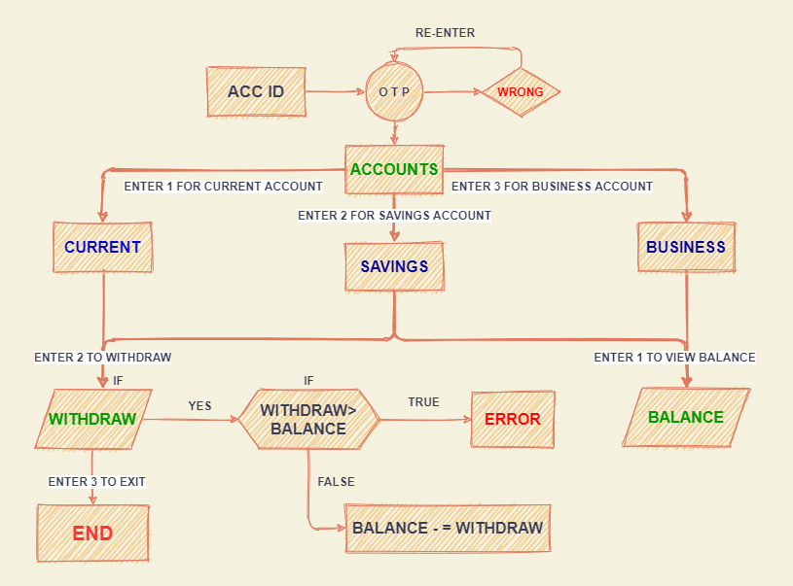
Flowchart

Slide 7
Applications
Used by banks, payment channels such as VISA, MasterCard, AMERICAN EXPRESS (and ATMs).
This program helps to the user to make transactions easier, faster and secure.
With recent events like the pandemic digital transaction have sky rocketed and to make quick payment is the need of hour.
Using Python it is easier and time efficient compared to primitive languages.
As the code is written in Python, it is more simple, scalable and portable.

Slide 8


